Slide 1
Use case analysis

Slide 2
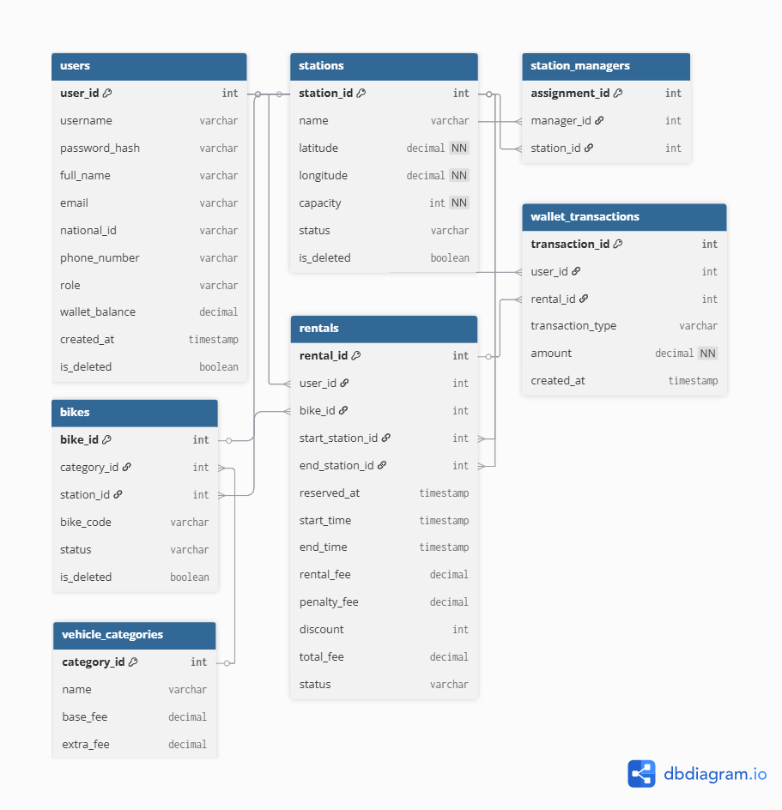
Relational Schema

Slide 3
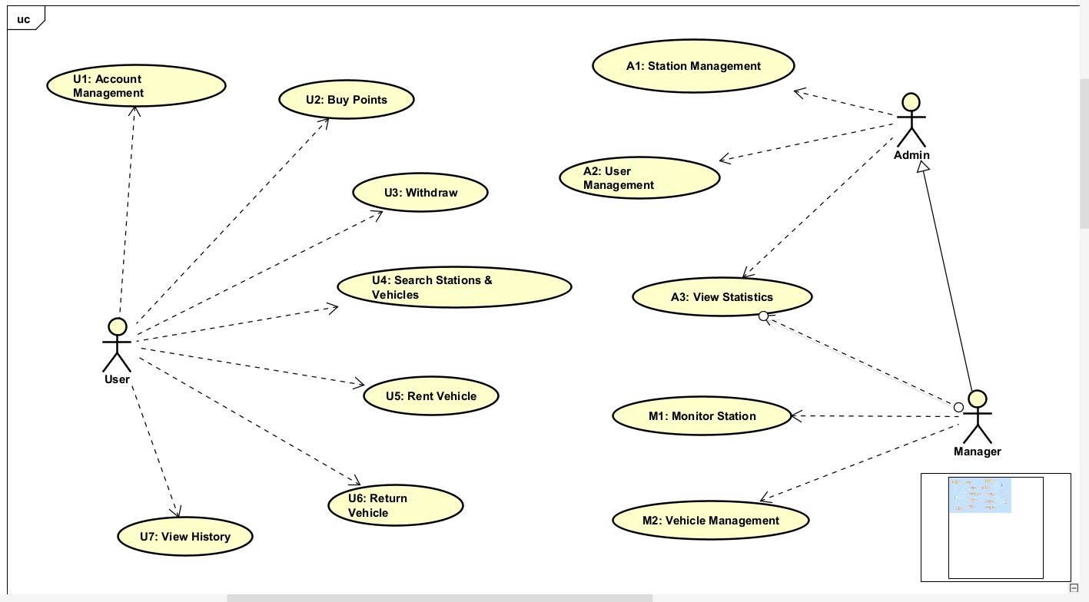
General Use Case Diagram

Slide 4
U1: Customer Account Management
Use Case Code | U1 | Use Case Name |  | Customer Account Management
Actor | Customer
Usage | Allow customers to register, log in, update profile information, and verify resident card information.
Activation Event | Customer opens the Account Management function or selects an account-related action.
Preconditions | The customer has access to the application. For login, profile update, and resident card verification, the account must already exist.
Main Event Flow | Index | Done by | Action | Action
 | 1 | Customer | Selects Account Management. | Selects Account Management.
 | 2 | System | Displays available account functions: Register, Login, Update Profile, and Verify Resident Card. | Displays available account functions: Register, Login, Update Profile, and Verify Resident Card.
 | 3 | Customer | Chooses the required account function. | Chooses the required account function.
 | 4 | System | Displays the corresponding form. | Displays the corresponding form.
 | 5 | Customer | Enters the required information. | Enters the required information.
 | 6 | System | Validates the submitted information. | Validates the submitted information.
 | 7 | System | Checks related account data in the database if needed. | Checks related account data in the database if needed.
 | 8 | System | Processes the selected account function and saves or updates data. | Processes the selected account function and saves or updates data.
 | 9 | System | Displays a success message or redirects the customer to the appropriate page. | Displays a success message or redirects the customer to the appropriate page.

Slide 5
U1: Customer Account Management
Alternative Flow | Index | Done by | Action
 | A1 | Customer | If the customer selects Register, the system checks whether the email already exists before creating a new account.
 | A2 | Customer | If the customer selects Login, the system authenticates the credentials and creates a session/token.
 | A3 | Customer | If the customer selects Update Profile, the system validates the new profile data and updates the customer record.
 | A4 | Customer | If the customer selects Verify Resident Card, the system checks the resident card and grants verified access when the card is valid.
Exception Flow | Index | Done by | Action
 | E1 | System | Registration is rejected when the email already exists. The system displays an 'Email already exists' message.
 | E2 | System | Login fails when the email or password is incorrect. The system displays an invalid credential message.
 | E3 | System | Profile update fails when required fields are missing or invalid. The system asks the customer to correct the data.
 | E4 | System | Resident card verification fails when the card is not found or invalid. The system denies verification.
Postconditions | The account is created, authenticated, updated, or verified successfully depending on the selected function.

Slide 6
U2: Buy Points
Use Case Code | U2 | Use Case Name |  | Buy Points / Top-up Points
Actor | Customer
Usage | Allow customers to buy points by making a payment through the system.
Activation Event | Customer selects the Buy Points or Top-up function.
Preconditions | The customer must be logged in. A valid payment method and the payment gateway must be available.
Main Event Flow | Index | Done by | Action | Action
 | 1 | Customer | Selects the Buy Points function. | Selects the Buy Points function.
 | 2 | System | Displays available point packages and payment methods. | Displays available point packages and payment methods.
 | 3 | Customer | Selects a package and confirms payment. | Selects a package and confirms payment.
 | 4 | System | Sends the payment request to the payment gateway. | Sends the payment request to the payment gateway.
 | 5 | Payment Gateway | Processes the payment transaction and returns payment confirmation. | Processes the payment transaction and returns payment confirmation.
 | 6 | System | Converts the paid amount into points according to the system conversion rate. | Converts the paid amount into points according to the system conversion rate.
 | 7 | System | Updates the customer wallet balance. | Updates the customer wallet balance.
 | 8 | System | Creates a point transaction record. | Creates a point transaction record.
 | 9 | System | Displays a successful top-up receipt to the customer. | Displays a successful top-up receipt to the customer.

Slide 7
U2: Buy Points
Alternative Flow | Index | Done by | Action
 | A1 | Customer | The customer changes the selected point package before confirming payment. The system recalculates the payable amount.
 | A2 | Customer | The customer cancels the payment before processing. The system stops the transaction and does not update the wallet.
 | A3 | System | If different payment methods are available, the system allows the customer to choose another valid method.
Exception Flow | Index | Done by | Action
 | E1 | Payment Gateway | Payment is declined or failed. The system displays a payment failure message and keeps the wallet unchanged.
 | E2 | System | The selected amount is invalid. The system rejects the request and asks the customer to choose a valid package.
 | E3 | Payment Gateway | The payment gateway times out. The system shows a pending or failed payment message depending on the gateway response.
 | E4 | System | Wallet update fails after payment confirmation. The system records the issue for rollback or manual support.
Postconditions | The customer's point balance increased, and a point transaction record is saved.

Slide 8
U4: Search Stations and Vehicles
Use Case Code | U4 | Use Case Name | Search Stations and Vehicles
Actor | Customer
Usage | Allow customers to search for nearby stations and view available vehicles.
Activation Event | Customer opens the map/search function or enters a location to search.
Preconditions | The application is available. The customer provides a search location or allows the system to use the current location.
Main Event Flow | Index | Done by | Action
 | 1 | Customer | Opens the search or map function.
 | 2 | Customer | Enters a location or allows the system to use the current location.
 | 3 | System | Receives and validates the location information.
 | 4 | System | Searches for nearby stations based on the location coordinates.
 | 5 | System | Retrieves station information from the database.
 | 6 | System | Retrieves available vehicle information for the matching stations.
 | 7 | System | Combines station data with available vehicle counts.
 | 8 | System | Displays stations and available vehicles on the map.
 | 9 | Customer | Views station details and selects a suitable station or vehicle.

Slide 9
U4: Search Stations and Vehicles
Alternative Flow | Index | Done by | Action
 | A1 | Customer | The customer uses current location instead of manual input. The system detects coordinates automatically.
 | A2 | Customer | The customer filters results by distance or vehicle availability. The system updates the displayed results.
 | A3 | System | A station is found but has no available vehicles. The system still displays the station with zero available vehicles.
 | A4 | Customer | The customer selects a station marker. The system displays station details and available vehicle information.
Exception Flow | Index | Done by | Action
 | E1 | System | The entered location is invalid. The system asks the customer to enter a valid location.
 | E2 | System | Location permission is denied. The system allows the customer to search manually.
 | E3 | System | No nearby stations are found. The system displays a 'No nearby stations found' message.
 | E4 | System | Station or vehicle data cannot be loaded. The system displays an error message and asks the customer to try again.
Postconditions | The customer can view nearby stations, available vehicle counts, and select a station or vehicle for rental.

Slide 10
U5: Rent Vehicle
Use Case Code | U5 | Use Case Name |  | Rent Vehicle
Actor | Customer
Usage | Allow customers to rent an available vehicle using points in their wallet.
Activation Event | Customer selects an available vehicle and clicks 'Rent Now'.
Preconditions | The customer must be logged in, have enough points, and the selected vehicle must be available.
Main Event Flow | Index | Done by | Action | Action
 | 1 | Customer | Selects an available vehicle from a station. | Selects an available vehicle from a station.
 | 2 | Customer | Clicks 'Rent Now'. | Clicks 'Rent Now'.
 | 3 | System | Receives the rental request with customer ID and vehicle ID. | Receives the rental request with customer ID and vehicle ID.
 | 4 | System | Checks the customer wallet balance. | Checks the customer wallet balance.
 | 5 | System | Checks the selected vehicle status. | Checks the selected vehicle status.
 | 6 | System | Confirms that the customer has enough points and the vehicle is available. | Confirms that the customer has enough points and the vehicle is available.
 | 7 | System | Creates a rental record. | Creates a rental record.
 | 8 | System | Updates the vehicle status to rented or in use. | Updates the vehicle status to rented or in use.
 | 9 | System | Deducts or reserves the required points if required by the rental policy. | Deducts or reserves the required points if required by the rental policy.
 | 10 | System | Generates an unlock code or unlock instruction. | Generates an unlock code or unlock instruction.
 | 11 | System | Displays rental confirmation and unlock code to the customer. | Displays rental confirmation and unlock code to the customer.
 | 12 | Customer | Uses the unlock code to start the rental. | Uses the unlock code to start the rental.

Slide 11
U5: Rent Vehicles
Alternative Flow | Index | Done by | Action
 | A1 | System | If the system uses a deposit mechanism, points are reserved at rental time and final fee is calculated at return time.
 | A2 | Customer | The customer changes the selected vehicle before confirming rental. The system processes the new selected vehicle.
 | A3 | Customer | The customer cancels the request before confirmation. The system does not create a rental record.
Exception Flow | Index | Done by | Action
 | E1 | System | The customer has insufficient points. The system rejects the rental request and displays 'Not enough points'.
 | E2 | System | The selected vehicle is unavailable, already rented, or under maintenance. The system asks the customer to choose another vehicle.
 | E3 | System | The customer already has an active rental. The system rejects the new rental request.
 | E4 | System | Unlock code generation fails. The system cancels or marks the rental as pending and asks the customer to try again or contact support.
 | E5 | System | Database update fails. The system rolls back the rental process and keeps vehicle and wallet status unchanged.
Postconditions | A rental record is created, the vehicle status is updated, and the customer receives the unlock code or rental confirmation.

Slide 12
U6: Return Vehicle
Use Case Code | U6 | Use Case Name |  | Return Vehicle
Actor | Customer
Usage | Allow customers to end a rental trip, return the vehicle, calculate fee or penalty, and update wallet balance.
Activation Event | Customer clicks 'Return Vehicle'.
Preconditions | The customer must have an active rental. The vehicle and return station information must be identifiable by the system.
Main Event Flow | Index | Done by | Action | Action
 | 1 | Customer | Selects Return Vehicle. | Selects Return Vehicle.
 | 2 | System | Receives the return request with rental ID and return station information. | Receives the return request with rental ID and return station information.
 | 3 | System | Retrieves rental details such as start time, vehicle ID, and customer ID. | Retrieves rental details such as start time, vehicle ID, and customer ID.
 | 4 | System | Calculates rental duration, rental fee, late penalty, and deposit refund if applicable. | Calculates rental duration, rental fee, late penalty, and deposit refund if applicable.
 | 5 | System | Updates the customer wallet balance according to fee, penalty, and refund. | Updates the customer wallet balance according to fee, penalty, and refund.
 | 6 | System | Updates the rental record with end time and return station. | Updates the rental record with end time and return station.
 | 7 | System | Updates the vehicle location and status to available. | Updates the vehicle location and status to available.
 | 8 | System | Creates point transaction records for fee, penalty, and refund. | Creates point transaction records for fee, penalty, and refund.
 | 9 | System | Displays total fee, refund information, and updated balance to the customer. | Displays total fee, refund information, and updated balance to the customer.

Slide 13
U6: Return Vehicle
Alternative Flow | Index | Done by | Action
 | A1 | System | The vehicle is returned within the allowed time. The system charges the normal fee and refunds the remaining deposit.
 | A2 | System | The vehicle is returned late. The system adds a late penalty before updating the wallet.
 | A3 | System | The vehicle is returned to a different allowed station. The system updates the return station and applies an extra fee if required.
 | A4 | System | If deposit is greater than the final fee, the system refunds the remaining points to the customer's wallet.
Exception Flow | Index | Done by | Action
 | E1 | System | The rental record is not found or has already been returned. The system rejects the return request.
 | E2 | System | The return station is invalid or not allowed. The system asks the customer to choose a valid return station.
 | E3 | System | The wallet balance is insufficient to pay the late penalty. The system marks the transaction for follow-up or requires additional points.
 | E4 | System | Rental, wallet, or vehicle status update fails. The system rolls back the operation and displays an error message.
Postconditions | The rental trip is closed, the vehicle status and location are updated, and the customer's wallet balance is recalculated.

